Slide 1
Pursuit of Continuous Improvement An Update to the WAVES Conference Joseph Garcia Executive Director, Education Service
July 2024

Slide 2
Education Service (EDU) Update Agenda
GI Bill History and Impact
EDU Vision, Mission & Strategic Initiatives
Continuous Improvement (Review progress)
Supreme Court Rudisill Decision
Q&A

Slide 3
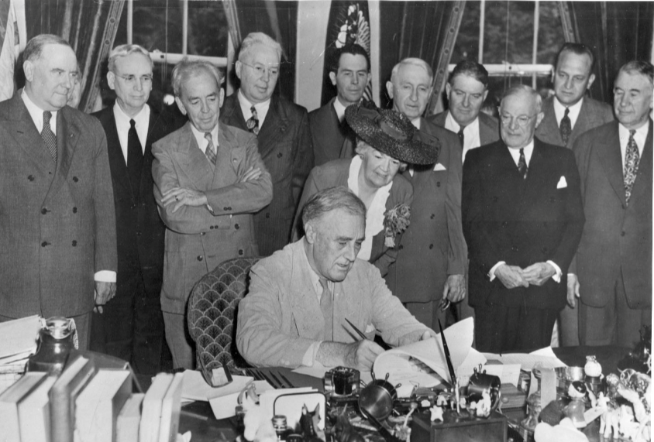
80 Years of GI Bill Benefits
On June 6, 1944, began invasion of the beaches at Normandy in Nazi occupied France by US and other troops. Codenamed Operation Overlord—the D-Day invasion was the largest naval, air and land operation in history. Historians often refer to D-Day as the beginning of the end of World War II.
On June 22, 1944, U.S. President Franklin D. Roosevelt signed the G.I. Bill, an unprecedented act of legislation designed to compensate returning members of the armed services—known as G.I.s—for their efforts in World War II.
The Servicemen Readjustment Act of 1944 is considered one of the most impactful program and legislation passed in nation’s history

Slide 5
EDU’s 4 Pillars supports Vision and Mission
WHAT HOW WHO

Slide 6
Program Integrity especially important

Slide 7
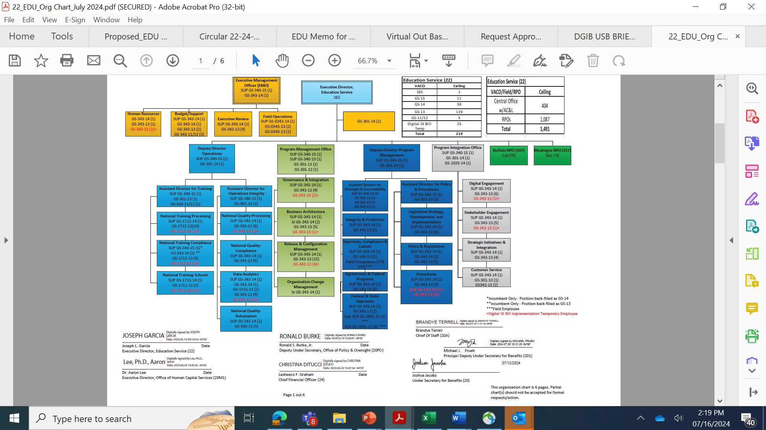

Slide 8
Digital GI Bill (DGIB) Journey
This timeline presents the key milestones met by the DGIB team to implement and migrate capabilities to the Managed Service. Significant DGIB progress has been achieved to date, improving the Veteran experience and outcomes. Eight major releases already completed, and two of the three largest legacy systems retired.*
Key Stakeholders
GI Bill Students
Schools
VA Employees
Other
Release 5
Release 6
The solid blue circles show key milestones the DGIB team has already met.
Enhanced Original Claim Application Processing
Benefits Manager non-33 for new beneficiaries
Enrollment Manager (retired VA-ONCE)
CH33 Payments
Integration ​
Legislative Release
Managed Service Go-Live (retired LTS)
Legislative Release
VET TEC
Managed Service
Go-Live Retired VET TEC
Service Improvements Release
Automated Original claims for first time in Education Service history,
included pre-filled service data and reduced processing time.
Data Mart
Introduced text enrollment verification for Institution of Higher Learning (IHL) students; included new email verification.
Enhanced SCO experience, streamlined processes, quicker information sharing, and a new GI Bill Chatbot.
One-stop shop to combine and transform EDU systems data, provide advanced analytics, and AI features.
Transfer payment processes from BDN to eMPWR. This marks the first step in BDN decommission.
Introduced enrollment verification via text for Non-College Degree (NCD) students.
Improve the VCE experience and streamline processes.
Modern-ization Journey Starts
Chapter 33 functionality live in Managed Service.
Included improved experience for VCEs and ECC staff.
Contract awarded.
Mar ‘21
Jul ‘21
Sept ‘21
Jan ‘22
Apr ‘22
May ‘22
Aug ‘22
Mar ‘23
Jun ‘23
Summer ‘24​
Future ‘24-‘25
* Largest legacy systems: LTS and VA-ONCE already consolidated into the Managed Service. Mainframe BDN remains to be done.

Slide 9
Enrollment Manager (June 2023)
10,490+
Institutions have submitted enrollments.
1,030,430+
Enrollment certifications for all chapters have been submitted since Enrollment Manager go live,
14,569+
Distinct users successfully accessed Enrollment Manager.
190
Enrollment Manager emails sent to SCOs, State Approving Agencies (SAAs), EDU staff, and relevant stakeholders.
81.7% As of May 10, 2023
Of covered institutions* have at least one SCO that completed all training courses.
*Institutions with at least 20 GI Bill students.
99%
Of users who have attempted to login are in the system.

Slide 10
DGIB Continuous Improvement Milestones
Key
Enrollment Manager and DGIB Systems
This timeline presents the key release milestones met in 2023.
Data Mart
Tech Refresh
Release 5.2.0 Introduced the ability to select the correct amendment reason when amending an enrollment with a future begin date. This release also improved Chatbot Billie functionality.
Major Release
Release 5.2.2
Introduced the ability to discard draft enrollments.
Ability to add parent school information for guest students.
Tech Refresh
Release 5.3
Updated Ch33 Oracle WebLogic and Databases that are used for processing Chapter 33 eligibility, to improve security posture, helping protect Veteran data.
Release 5.3.1
The facility dropdown is now pre-populated with schools the SCO is associated with, SCOs can now filter their students based on a date range and school facility name.
Data Mart Release 1.2
Introduced two new dashboards: National Training Team School Dashboard and the Payments Analysis Dashboard.
Release 5.3.2.12
Added an inactivity
warning message two minutes prior to SCOs’ EM session expiring.
Data Mart Release 1.2.1
Migration of analytics workflows to the reusable framework. Improves end-user's self-service analytics capabilities.
Release 5.1.2
Allowed SCOs to create Chapter 35 student enrollments in EM, and made
enhancements to the Student’s Profile and Benefits tab.
Release 5.1.4
Updated academic information displays, alphabetically sorted the “Students Tab” filter dropdown fields for easier system navigation.
Release 5.1.3
Expanded SCOs capabilities for updating additional student academic information and made improvements to the resources available to SCOS within EM.
Release 5.2.1
Introduced the ability for SCOs to save, edit, and delete a new
Student ID on their students’ profiles​. Submit new enrollments and amendments for pre-existing VRRAP students​.
Data Mart
Release 1.1
Introduced the foundation to enable the Artificial Intelligence /Machine Learning pipeline to the Data Mart Analytics Platform (DMAP), including three AI/ML School Risk Monitoring models.
Data Mart Release 1.0 Delivered a one-stop shop database to combine and transform EDU systems data into one consolidated database and improve reporting capabilities.
Release 5.3.2
Removed the ability for SCOs to add custom remarks for Chapter 33 Institution of Higher Learning and Non-College Degree claims (exceptions apply). Automation improvements.
Release 5 Introduced Enrollment Manager, My Education Benefits (MEB) for Transfer of Entitlement (TOE) and Online Enrollment Verification
Release 5.1.5
Migrated historical enrollments data at extension campus from VA-ONCE to EM.
Release 5.3.2.4
Ability to submit amendments with term dates that start in the future in EM.
Release 5.3.3
Introduced Automation for select NCD claims. Updated Enrollment Verification text messages. Introduced ability to update CH35 benefit type.
March 6, 2023
March 8, 2023
March 11, 2023
March 18, 2023
March 25, 2023
April 8, 2023
May 21, 2023
June 17, 2023
June 21, 2023
July 16, 2023
July 31, 2023
August 19, 2023
October 8, 2023
October 25, 2023
November 4, 2023
November 17, 2023
December 16, 2023
December 19, 2023

Slide 11
Enrollment Manager (July 2024)
24,768
Cumulative count of distinct users who have accessed the Digital GI Bill system. 99.9% of users who have attempted to log in are in the system.
6,576,291+
Enrollment certifications for all chapters have been submitted since Enrollment Manager go live.
759+
Active Enrollment Manager internal users (VA)
98%*
Of SCOs have completed at least one online training.
*Based on the assumption of 20,000 total active SCOs
16,730+
Institutions have submitted enrollments.
19,490+
Active Enrollment Manager external users (SCOs and other users with distinct roles)
Data as of July 17, 2024

Slide 12
Release 6 Impacts
Release 6 transitioned all Chapter 33 payments processing from Benefits Delivery Network (BDN) to a modernized payments platform the Enterprise Management of Payments, Workload, and Reporting (eMPWR), marking the first major step towards decommissioning VA’s 50+ year old legacy mainframe — Benefits Delivery Network (BDN).
Impact to VA
System and Data Integration
Benefits Processing
Permanently integrated VA’s three authoritative databases with the Digital GI Bill Managed Service: VBA’s Corporate Database (CorpDB), Master Person Index (MPI), and VA Profile.
Automated intake of VA/DOD Identity Repository (VADIR) and service history updates, increasing supplemental claims automation.
Provides a smoother Chapter 33 claims processing experience for Veteran Claims Examiners (VCEs), by integrating claims processing to a single platform.
Enabled data reciprocity and interoperability for the first time ever, allowing VA to consolidate its data sources and synchronize data across platforms.
Integrated with the Debt Management Center (DMC) and deployed a new DMC batch interface that allows DMC staff to see necessary education benefits award data so they can recoup debts more efficiently.
Moved 87% of all payments processing off BDN, significantly reducing security risks and system maintenance costs to VA.

Slide 13
Impact to Veterans
Allows Veterans to receive education benefits and eligibility decisions even faster, with more accurate service history information and real-time updates.
Creates a better experience for Chapter 33 beneficiaries, with improved data retrieval processes making it easier to update their payment address information.
Processes Chapter 33 payments though a more secure, efficient, and accurate platform, reducing likelihood of overpayments, debts, and security risks.
Provides information on Chapter 33 payments and debts in one place by consolidating seven payment letters into one.
Just five days after Release 6 go-live, VA:
Processed approximately 80,000 claims for 75,000 claimants.
Transmitted approximately $88,000,000 in payments to eMPWR, with a 99.9% success rate.
Metrics as of 5 p.m. ET on Friday, July 12.

Slide 14
Supplemental & Original Claims Automation Update
The DGIB team continues to focus on automation, in line with our overall program objectives, to improve Post-9/11 GI Bill supplemental and original claims automation.
Chapter 33 Original Claims
Trending towards
23%
Mid-May 2023 Supplemental Claims Automation: 63%
Automation for May 2023.
Mid-May 2023 Original Claims Automation: 23%
Chapter 33 Supplemental Claims
Trending towards
DGIB Contract Begins
(Mar 2021)
63%
Automation for May 2023.
Data as of 05/17/23

Slide 15
Digital GI Bill Automation Overview Program Initiatives and Improvements
Upcoming Automation Improvements
Automation Release Milestones
July 2024 – Release 6
VADIR Service History Ingestion | SUPP | See R6 Fast Follow | On Track
New Termination VBA Remark | SUPP | Quality | On Track
Clock Hours VBA Remark Update | SUPP | Quality | On Track
AM1999/E1999 Defects | SUPP | Quality | On Track
MITC 1, 2, 4 (Letters) | SUPP | +1-2% | On Track
NEW OFFRAMP: eMPWR Non-Converted Claims | SUPP | Payment Quality | On Track
July 2024 – Release 6 Fast-Follow
ARNG A25 Offramp(s) | ORIG/SUPP | Quality | On Track
Change in VADIR Service History – Offramp Disablement | ORIG/SUPP | +3-5% | On Track
September 2024 – Release 6.1
MEB TOE No-Sponsor Denials | ORIG | +6% | On Track
MEB TOE (Easy Path) | ORIG | TBD | On Track
Excluded Periods Enhancement | ORIG | Quality | On Track
NCD Automation (Phase 3) | SUPP | Quality | On Track
Follow-On Release(s)
Initial Non-33 UI + Automation | ORIG/SUPP | REQs target 3/29 | R7 Target
MEB TOE + Sponsor Original | ORIG | REQs target 6/28 | TBD
Automation Performance – May 2024
CH33 | Claim Type | Auto % | Automated | Received
System Intake¹ | Original | 47.5% | 5,164 | 10,872
 | Supplemental | 69.7% | 122,178 | 175,234
CH33 | Claim Type | Auto % | Automated | Completed
Claims Authorized² | Original | 34.0% | 5,164 | 15,193
 | Supplemental | 60.7% | 122,178 | 201,242
Combined Automation | Total | 58.8% | 127,342 | 216,435
¹Claims received through or generated by DGIB systems only
²Claims completed/authorized, including claims manually created claims by VCEs
Month to date as of 5/27/2024

Slide 16
Staffing & Recruitment (FY22 vs. 2023)
FY22
AC&L Division experienced a total loss of 19 of 76 ELRs or 25% of the staff in FY 22.
FY23
Authorized Ceiling | Current On-Board | Hires Pending Recruitment Action | Hires Pending HRC Action | Hires Pending Selection Process | Hires Pending Offer Process
185 | 178 | 1 | 4 | 0 | 2
Vacancies
ELR | 3
ECSS | 2
SCLS | 2
Total | 7

Slide 17
Staffing & Recruitment (FY23 vs. FY24)
FY22
AC&L Division experienced a total loss of 19 of 76 ELRs or 25% of the staff in FY 22.
FY24
Authorized Ceiling | Current On-Board | Hires Pending Recruitment Action | Hires Pending HRC Action | Hires Pending Selection Process | Hires Pending Offer Process
185 | 180 | 1 | 4 | 0 | 0
Vacancies
ELR | 1 (99% staffed)
ECSS | 3 (95% staffed)
SCLS | 1 (99% staffed)
Total | 5

Slide 18
AC&L New Mentoring Program
During FY24 AC&L created a mentorship program for all Education Liaison Representative (ELR) and Education Compliance Survey Specialist (ECSS) team members.
Purpose: The goal is to increase team synergy within AC&L, foster a healthy working environment to include:
Increase individual and AC&L division quality.
Enhance employee skills.
Build relationships in a virtual environment.
Continuous improvement and sharing of knowledge.
Decrease burnout.
Provide growth opportunities.
Create a positive employee experience and personal satisfaction.
Boost employee engagement.
Voluntary participation.

Slide 19
FY23 Program Approvals*
Performance Standard Fully Successful = 37 Exceeds Fully Successful = 34 Outstanding = 30 | ADC Month
October | 37.7
November | 40.6
December | 36.8
January | 35.0
February | 35.9
March | 32.9
April | 29.6
May | 27.2
Metric: Timely completion of all approval information from SAA (*and other sources, 8794, 85/15, etc)
Average Day to Complete (ADC)
ADC exceeded targets due to focus on 35% exemption applications following enactment of the Best Schools for Veterans Act of 2022
Instituted plan for improving timeliness by prioritizing and brokering program approval

Slide 20
FY24 Program Approvals*
Performance Standard | ADC Month
Fully Successful = 37
Exceeds Fully Successful = 34
Outstanding = 30
October | 4.1
November | 4.6
December | 5.1
January | 4.9
February | 5.0
March | 5.0
April | 4.9
May | 4.8
Metric: Timely completion of all approval information from SAA (*and other sources, 8794, 85/15, etc)
Average Day to Complete (ADC)
ELR focus
Near full staffing (emphasized training)
SCO File Upload Portal (quicker turn)
Salesforce enhancements (managed)

Slide 21
Risk Based Surveys Reduction
October 1, 2022 - April 30, 2023
RBS Assigned | 1,286
RBS Completed | 657
Percent Completed | 51%
Total Underpayments | $51,214
Total Overpayments | $203,714
October 1, 2023 - April 30, 2024
RBS Assigned | 325
RBS Completed | 254
Percent Completed | 78%
Total Underpayments | $73,337
Total Overpayments | $351,475

Slide 22
CERTIFYING OFFICIAL RESOURCE GUIDE |  |  |  |  |  | *SCO Resource Page*
Issue | ELR | SCO Hotline | SAA | Ask VA | VR&E | Resource
Updating Certifying Officials; VA Form 22-8794 | X |  |  |  |  | SCO Training FAQ
Technical assistance with reporting enrollments | X |  |  |  |  | SCO Handbook
Access to Enrollment Manager and related technical guidance | X |  |  |  |  | EM User Guide
85/15 reporting matters | X |  |  |  |  | 85/15 Frequently Asked Questions
Clarification on WEAMS 1998 reports | X
Explanation of school overpayments or other payment issues |  | X |  | X
Request list of all overpayments by facility code or trouble- shoot debt repayment issues |  |  |  | X |  | DMC Power Point
Individual student benefit information and hardship cases |  | X |  | X
Updated catalogs and programs. New/suspended/cancelled programs. |  |  | X
School address updates – including branch/extension |  |  | X
Changes in accreditation status, ownership or change of address |  |  | X
Chapter 31 Questions and Concerns |  |  |  |  | X | VRE Handbook + update link to VR&E Officer Contact List that’s broken
Chapter 31 e-Authorization and Invoicing |  |  |  |  | X | VRE e-Authorization and e-Invoicing

Slide 23
SCO Matrix 2024
SCO Resource Matrix (adobeconnect.com)

Slide 24
Communication and Outreach
Outreach Events include:
Bowie State University
Dillard University
University of Nevada @ Las Vegas
Emory University/Clark University
American University
George Mason University
Univ. of Maryland, Baltimore County
Purdue University
Syracuse University
Florida Assn Of Veterans Ed. Specialists
Western Assn Of Veteran Ed. Specialists
Natl Assn of State Approving Agencies
AVECO Conference
Student Veterans of America Event
Natl Assn of Vet Prog. Administrators
Comms include:
SCO & Student Newsletters
Facebook Postings
LinkedIn (pursuing)
Emails
College Leadership
Regular Office Hours
New Fireside Chats
SCO Resource Page
Education Roundtable
SCO Collaboration Groups
GI Bill Roadshow – Bowie State University (HBCU)
Roadshow stop on April 10, 2024, included a School Certifying Officials (SCOs) Workshop, a GI Bill Town Hall and a Veterans Benefits Fair. These events provide Veterans, Service Members, GI Bill Students, their families, SCOs and school leadership the opportunity to connect with EDU and learn about GI Bill modernization and the Enrollment Manager new system.

Slide 25
Legislation (proposed)
Book Stipend Increase
Would increase the annual stipend for books, supplies and equipment from $1,000 to $1,400 under the Post-9/11 GI Bill
Would establish an annual increase equal to the CPI
Effective Fiscal Year 2025

Slide 26
Rudisill Issue and Supreme Court Decision
Issue: Pertains to individuals with multiple periods of active-duty service who have used Montgomery GI Bill – Active Duty (MGIB-AD) benefits and relinquished MGIB-AD benefits for the Post-9/11 GI Bill (PGIB), and whether their PGIB entitlement is limited to the remaining MGIB-AD entitlement or the 48-month rule. By law, the maximum amount of benefit entitlement that can be used under more than one benefit is limited to 48-months (excluding DEA and VR&E).
Ruling: The Court’s ruling invalidates VA’s statutory interpretation that a Veteran who qualifies for both the Montgomery GI Bill (MGIB) and PGIB based on multiple periods of service must forfeit eligibility for MGIB when they start using PGIB. It also invalidates VA’s statutory interpretation that such a person’s PGIB is limited to the months of entitlement remaining under MGIB. The Supreme Court has determined that the 48-month rule applies in this scenario.

Slide 27
Rudisill Supreme Court Decision Impact
Impacted Veterans would be able to continue using MGIB after using all their PGIB benefits
Impacted Veterans would not have PGIB benefits restricted to only the months of entitlement remaining under MGIB
Example: Veteran used 10 out of available 36 months of MGIB and converts to PGIB
Current Rules: Veteran would only receive 26 months of PGIB
Under Rudisill decision: Veteran would receive 36 months of PGIB (and can continue using more MGIB after exhausting PGIB)

